Slide 1




ICT for Interoperable Fare Management and Intelligent Transport Systems
Lorena Bourg
HoPE Project Coordinator
Head of Innovation and Product Department
1st MOVESMART workshop| 15 October 2015

Slide 2














33 Months
Start date: 1st June 2014

Slide 3
Motivation
By 2030, 6 out of every 10 people will live in a city. By 2050, this proportion will increase to 7 out of 10.
New urban mobility services in metropolitan areas are urgently needed in order to reduce congestion and carbon emissions and to provide sustainable mobility

Slide 4
General objective of the project
HOPE will explore ICT-based measures to radically strengthen the role of public transports by making them more user-friendly and widely adopted using new approaches in:
Interoperable Fare Management (IFM)
Intelligent Transport Systems (ITS)

Slide 5
Objectives of the project
1) Objective 1: Interoperable Fare Management (IFM) between modes, cities and regions

Slide 6
Objectives of the project
1) Objective 1: Interoperable Fare Management (IFM) between cities and regions
HoPE will validate IFM in the pilot’s location (including different cities, Athens and Coventry, and a Region, Basque Country.
The project will make public an API for other transport operators in other regions or cities to use IFM capabilities.

Slide 7
Objectives of the project
2) Objective 2: Make public transport more user friendly

Slide 8
Objectives of the project
2) Objective 2: Make public transport more user friendly
HoPE plans to deliver two mobile applications for this purpose: The Route Planner will incoporate capabilities for more user friendly transportation for local citizens and the Tourist Planner will serve the same purpose oriented to Tourists.

Slide 9
Objectives of the project
3) Objective 3: Help public transport operators to offer travelers packages covering all modes of transportation, personalised and managed.

Slide 10
Objectives of the project
3) Objective 3: Help public transport operators to offer travelers packages covering all modes of transportation, personalised and managed.
The mobile applications will gather information about the use and interactions that the users make with the applications (appropriately anonymized)
Transport operators will have access to this information trough the Web portal of the Platform

Slide 11
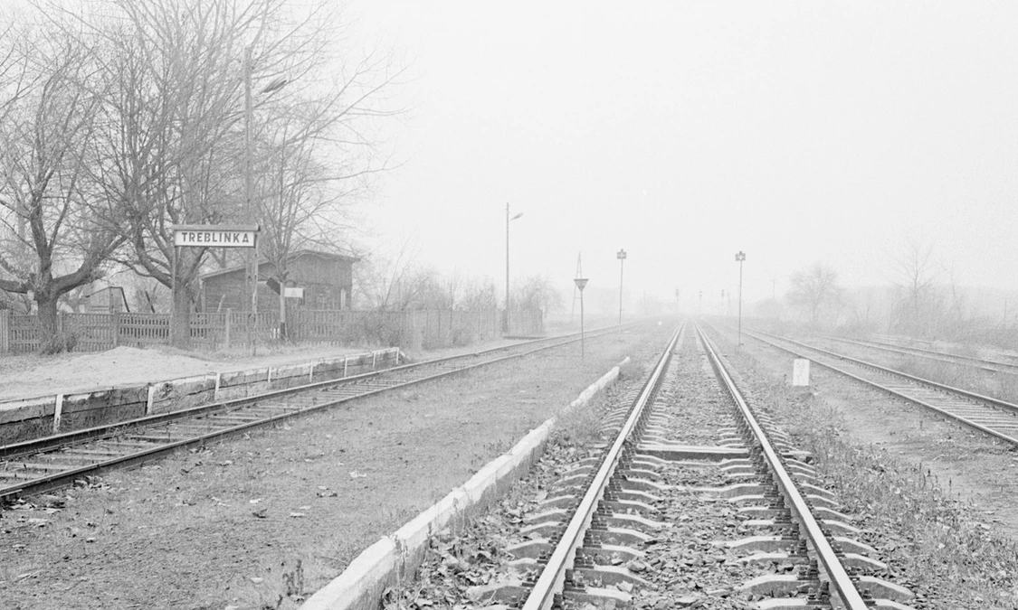
What we have so far…

Slide 12
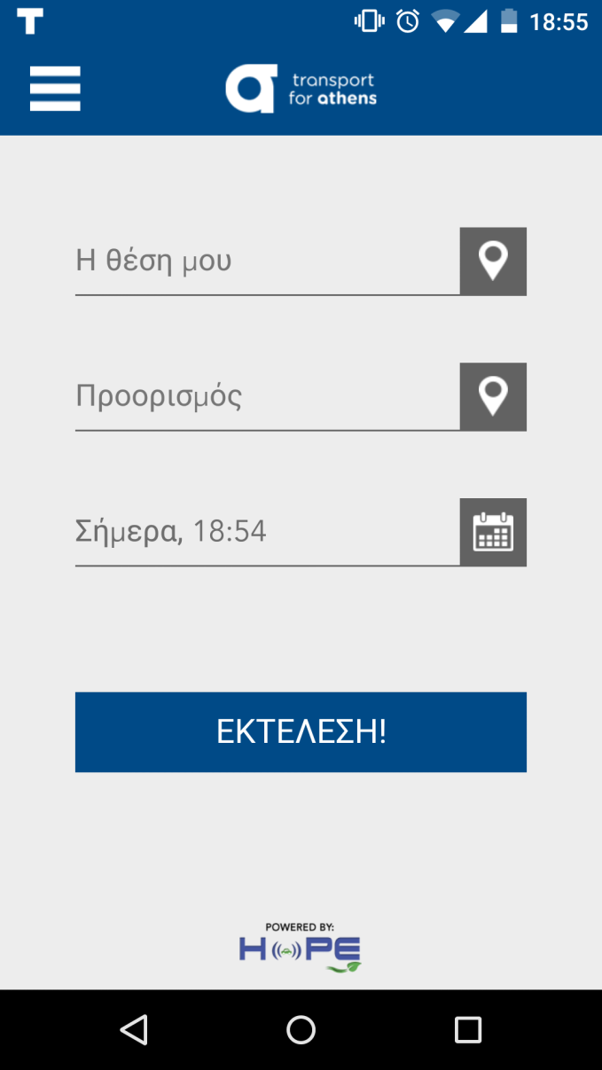
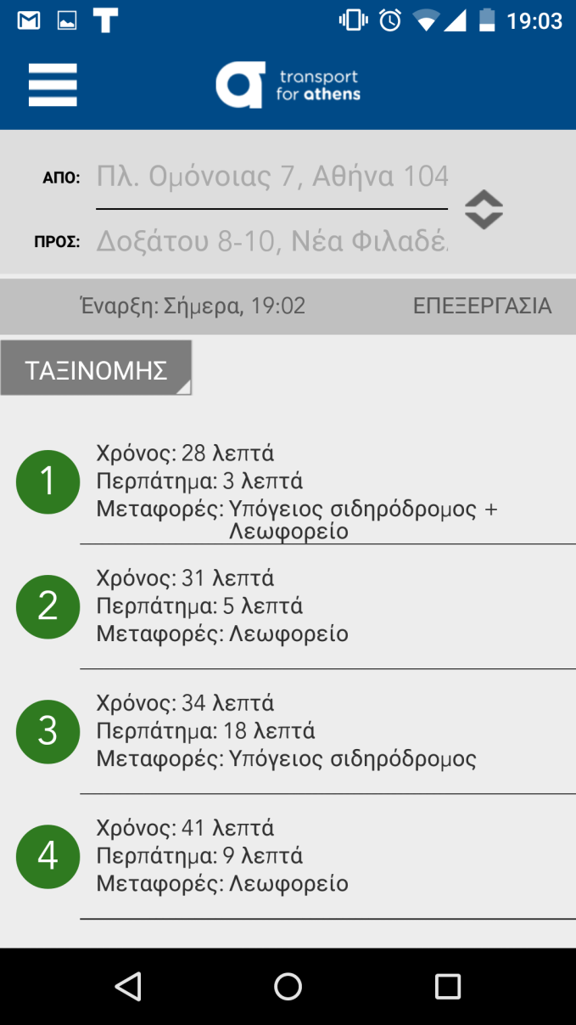
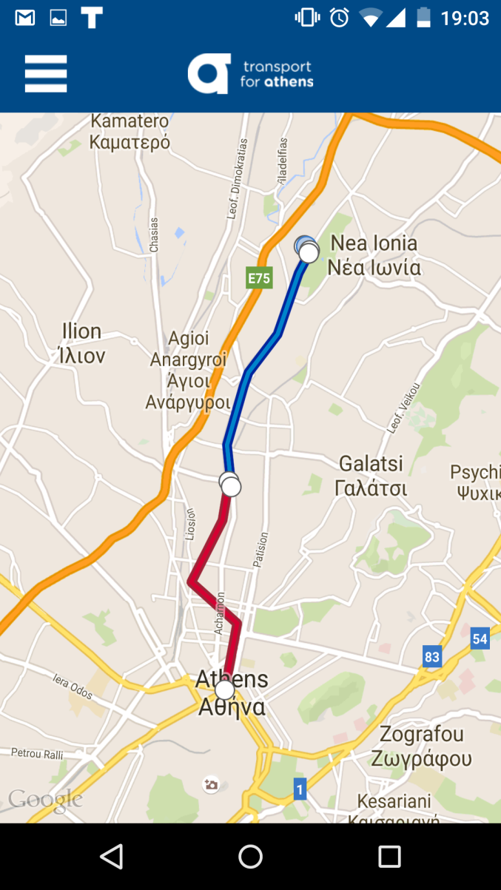
Route planner: OASA Athens

Slide 13
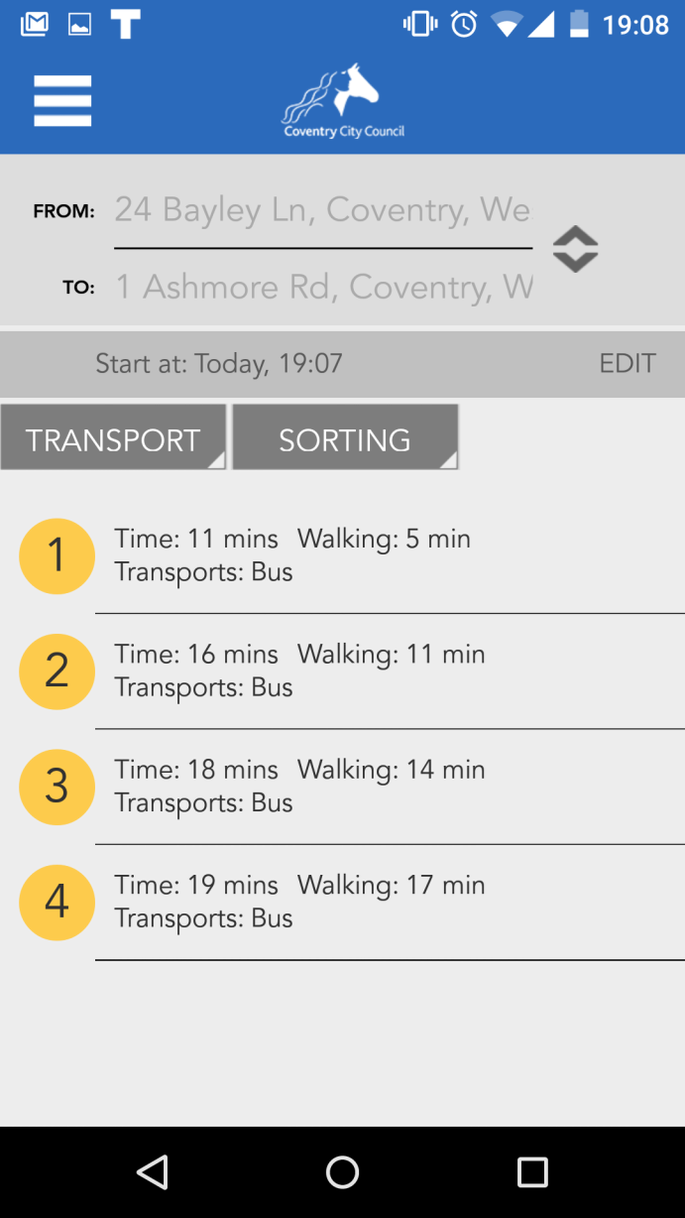
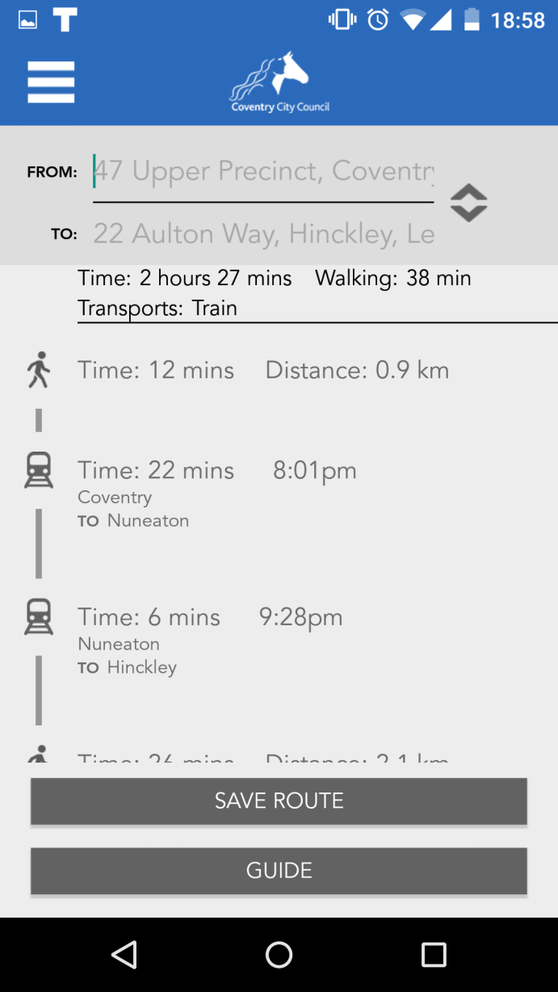
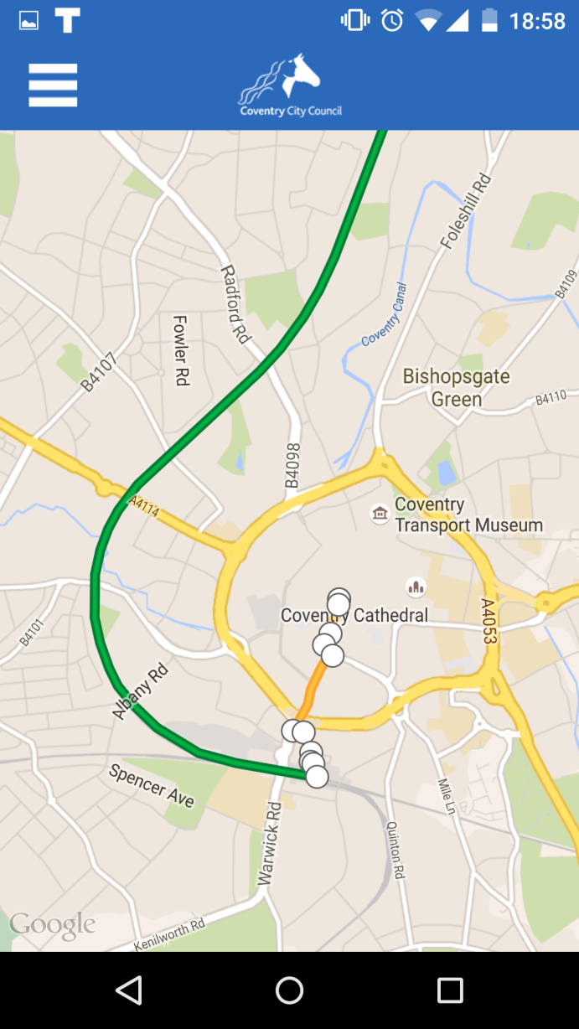
Route planner: Coventry City Council

Slide 14
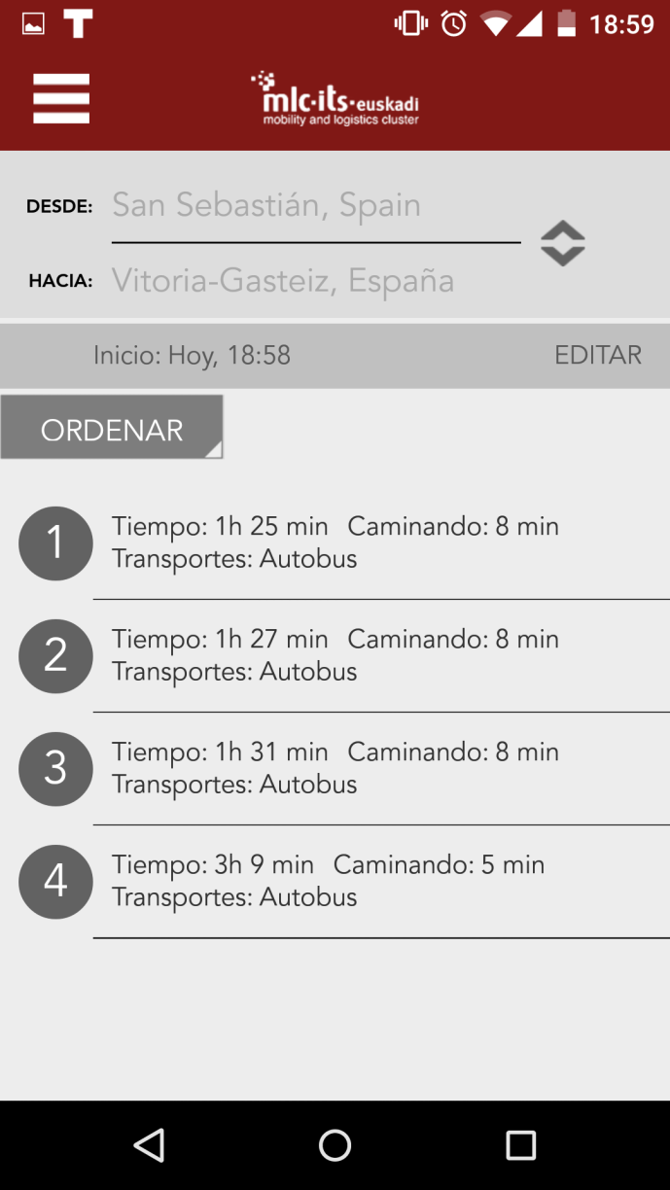
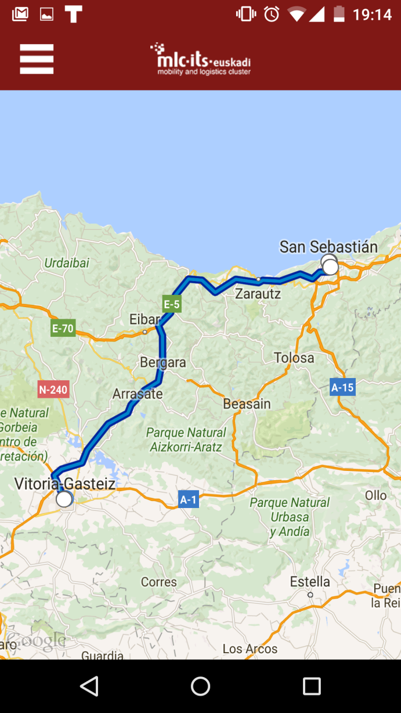
Route Planner: Basque Country

Slide 15

The
1st MOVESMART workshop| 15 October 2015

Slide 16
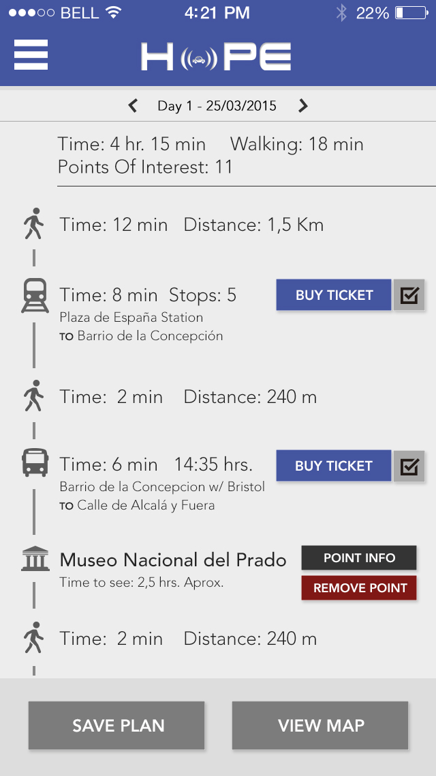
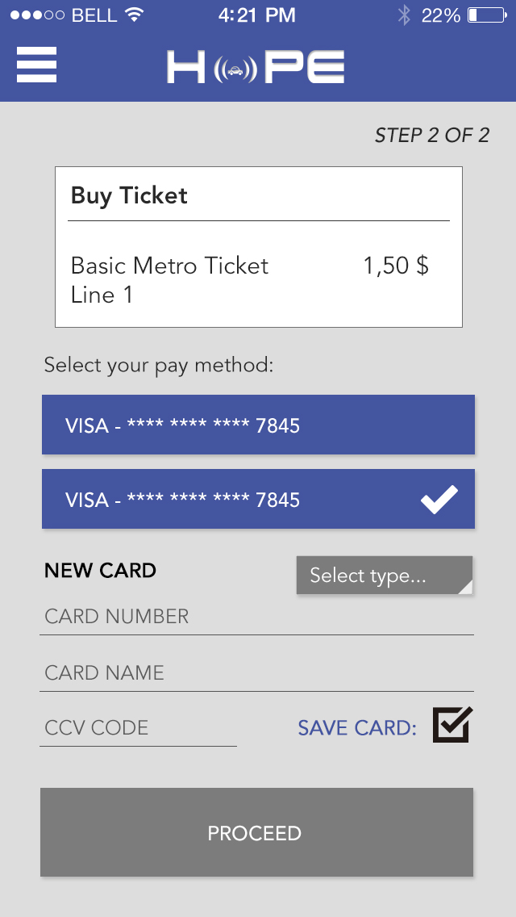
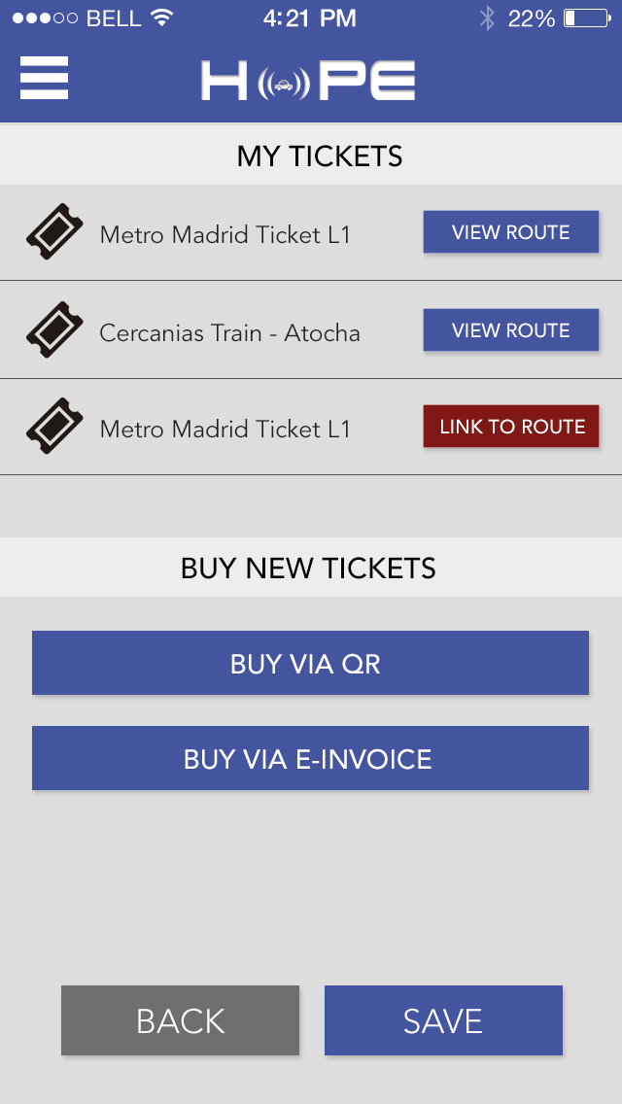
Fare & Ticket Management

Slide 17
Meet us at
The 1st HoPE Workshop
26th November – Karlshure, Germany

Slide 18
Meet us at
The 1st HoPE Workshop
26th November – Karlshure, Germany
A meeting point between Cities and Mobility projects

Slide 19
Meet us at
The 1st HoPE Workshop
26th November – Karlshure, Germany
A meeting point between Cities and Mobility projects
Contact us if you want to participate
sven.maerivoet@tmleuven.be

Slide 20
Thank you
Lorena Bourg
lorena.bourg@planetmedia.es

